Slide 1
Zephyr RTOS on Renesas RA
Introduction

Slide 2
Zephyr RTOS
Implements many features
Kernel services
Scheduling Algorithms
Memory protection
Communication stack (networking, bluetooth)
Highly configurable / Modular for flexibility
Compile-time resource definition (Kconfig, graphical configuration interface)
Devicetree Support

Slide 3
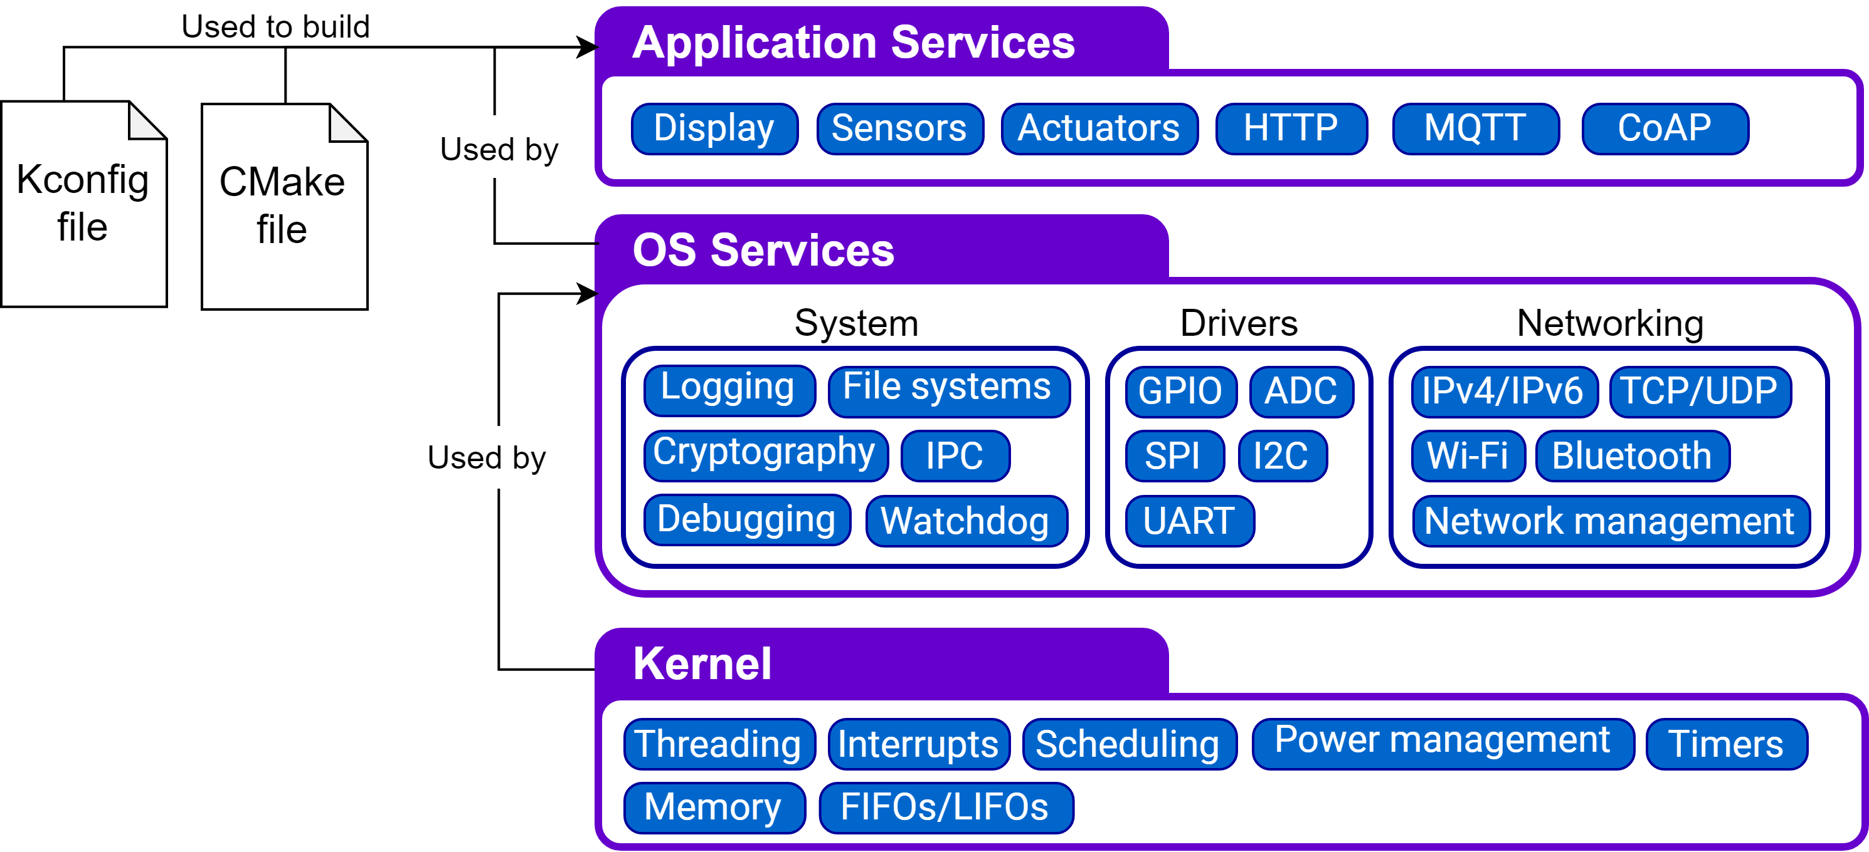
Zephyr RTOS - Module Organization

Slide 4
Zephyr hardware hierarchy
Architecture; ex: arm
CPU Core; ex: Cortex_M4
SoC Family; Common configurations and peripherals for one family, ex: Renesas RA
SoC Series; Common configurations and peripherals for one series, ex: RA4, RA6
Soc; Controller specific configurations and peripherals, ex: R7FA4W1AD
Drivers: Follows a device model API that is interfaced with the kernel
Board: Includes the SoC and the boards specific peripherals, features, external components and devices

Slide 5
Zephyr on Renesas RA development boards
Adding Renesas FSP as HAL
Defining the SoC
Defining/interfacing drivers
Adding board definition
Sample application (EK-RA4W1 - Bluetooth)

Slide 6
Renesas FSP as HAL
Manly register address and structures are used.
For Bluetooth sample application some drivers are included (BLE_LIB dependencies).
New HAL modules must be declared in zephyr:
Zephyrproject\Zephyr\west.yml
name: hal_renesas
revision: 9b01a0efcc3044a4f1e5bc6207c8565f78661434
path: modules/hal/renesas
Zephyrproject\Zephyr\modules\Kconfig
source "modules/Kconfig.renesas"
Zephyrproject\Zephyr\modules\Kconfig.renesas
config FSP
bool
select HAS_CMSIS_CORE
depends on SOC_FAMILY_RA
Used resources are configured by means of “cmakelist”,
ex: usage of GPT driver in Cmakelist.txt - zephyr_library_sources_ifdef(CONFIG_RENESAS_DRIVER_GPT r_gpt.c)
GPT driver shall be included into the build process if CONFIG_RENESAS_DRIVER_GPT is defined
symbol CONFIG_RENESAS_DRIVER_GPT can be define ether in the SoC kconfig or the application configuration

Slide 7
Definition of the SoC
Location: soc/<architecture>/<soc_family>/<soc_series>/<soc>
RA family configuration:
Zephyrproject\Zephyr\soc\arm\renesas_ra\ Kconfig.defconfig
Zephyrproject\Zephyr\soc\arm\renesas_ra\ Kconfig.soc
Zephyrproject\Zephyr\soc\arm\renesas_ra\ Kconfig
Configurations for RA4W1:
Zephyrproject\Zephyr\soc\arm\renesas_ra\ra\ra4w1\Kconfig.defconfig.series
Zephyrproject\Zephyr\soc\arm\renesas_ra\ra\ra4w1\Kconfig.soc
Zephyrproject\Zephyr\soc\arm\renesas_ra\ra\ra4w1\Kconfig.series
RA4W1 initialization:
Initialization of RA4W1 is done in: soc\arm\renesas_ra\ra\ra4w1\soc.c by calling SystemInit() from “bsp\cmsis\Device\RENESAS\Source\system.c”
Implementation is For RA6 the initialization is implemented in soc.c based on Renesas BSP, as for RA6 FSP drivers and BSP are not included.

Slide 8
Definition of the SoC – device tree
Location: dts/arm/<vendor>/<soc>.dtsi
A devicetree is a hierarchical data structure that describes hardware.
<soc>.dtsi – devicetree include describes SoC specific hardware: cpu, memory, peripherals
Exemple of RA4W1 devicetree entry that describes port 0:
port0: port@40040000 {
compatible = "renesas,ra-gpio";
gpio-controller;
#gpio-cells = <2>;
reg = <0x40040000 0x20>, <0x40040800 0x40>;
label = "PORT0";
#renesas,pin-cells = <2>;
};
Fields required/declared in the dtsi file are defined in binding files “.yaml”. These can be changed as the driver implementation requires other or additional information about the peripheral.
This information will be parsed before the build and generate define symbols used by the driver.

Slide 9
Defining/interfacing drivers
Driver location: Zephyr/drivers/<driver_type>/<driver_type>_<soc>.c
ex: GPIO driver for RA family: drivers/gpio/gpio_ra.c
Driver implementation must follow device model API that is defined in include/drivers/<driver_type>.h
ex: GPIO driver shall include <drivers/gpio.h> and provide implementation for the APIs required by gpio_driver_api
API implementation can be done by interfacing with the driver provided by the HAL module (if posible) or by implementation according to the SoC requirements.
For RA family the GPIO driver was rewritten as Renesas FSP APIs depend also on generated configuration files.
Through zephyr code and configuration files, peripherals are addressed by a “compatibility” symbol:
Driver source code: #define DT_DRV_COMPAT renesas_ra_gpio
DTS include file: compatible = "renesas,ra-gpio";
Binding file: compatible: "renesas,ra-gpio"

Slide 10
Adding board definition
Location: boards/<architecture>/<board_name>
The board is defined by the following files:
board.cmake – flashing and debug information. In the case of RA family “openocd” doesn’t support them and the information is not used at the moment.
<board_name>_defconfig – configuration and enabling/disabling of board features
CONFIG_SOC_SERIES_RA=y
CONFIG_SOC_PART_NUMBER_RA4W1=y
CONFIG_BOARD_EK_RA4W1=y
<board_name>.yaml – board general information: toolchain, architecture, available memory
Kconfig.board – definition of available features which can be enabled/disabled in <board_name>_defconfig
Kconfig.defconfig – definition and setting of default configurations, that are mandatory for the use of the board.
config GPIO
default y
<board_name>.dts - Board device tree

Slide 11
Adding board definition – device tree
< board_name >.dts – devicetree describes board specific features
This includes the <soc>.dtsi and configures/alocates the SoC peripheral, examples from ek_ra4w1.dts
Setting the cpu clock:
&cpu0 {
clock-frequency = <32000000>;
};
Enabling and configuration of sci4
&sci4 {
status = "okay";
current-speed = <115200>;
};
Allocation of sci4 as console output for zephyr printk
zephyr,console = &sci4;
Definition of the green LED on the board:
green_led: led_0 {
gpios = <&port1 6 0>;
label = "User LED";
};

Slide 12
EK-RA4W1 – Bluetooth sample application
Based on Renesas Bluetooth sample application
Bluetooth sample application feature:
LED blink rate change between 100 – 25500 ms, based on the value sent from Renesas GATTBrowser mobile application 0x01 – 0xFF.
EK-RA4W1 – User Button press notification Renesas GATTBrowser mobile application.
Requires deviation from standard zephyr implementation as BLE_LIB depends on FSP drivers and generated configuration source code
The configuration source code was generated using FSP configurator in E2Studio and copied and included in the sample project.
User LED gpio is controlled via Zephyr OS GPIO interface.
User Button gpio is set up as interrupt using Renesas FSP api and driver. BLE library interrupt is defined using Renesas Configurator, making Zephyr OS interrupt interface incompatible.

Slide 13
Reference
Zephyr introduction: https://docs.zephyrproject.org/latest/introduction/index.html
Enabling Zephyr on Your Hardware Platform - https://www.youtube.com/watch?v=R0GCLJRCYW0&t=823s
Devicetree introduction: https://docs.zephyrproject.org/latest/guides/dts/intro.html
Grafical Kconfig interfaces: https://docs.zephyrproject.org/latest/guides/kconfig/menuconfig.html?highlight=guiconfig

